Slide 1
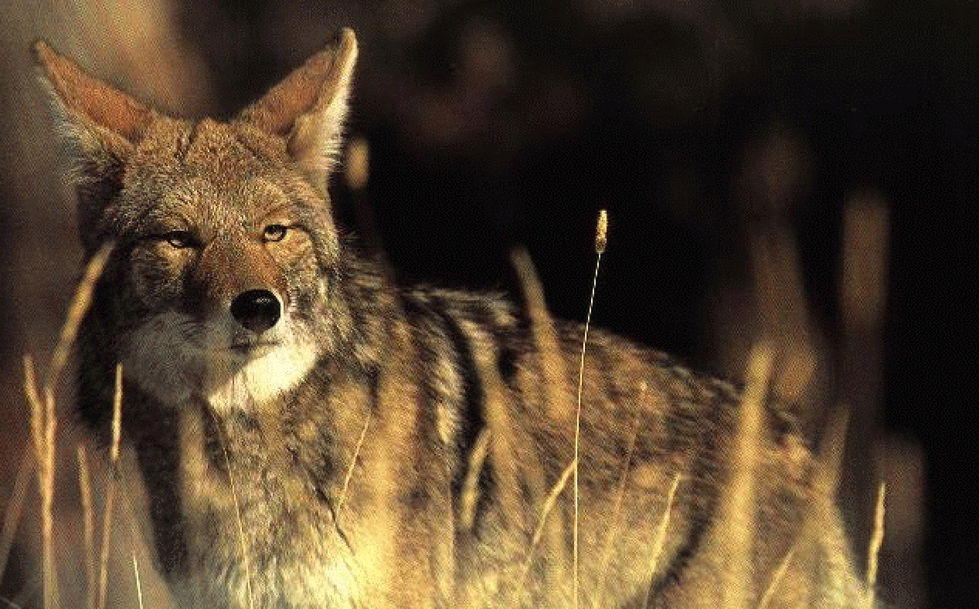
Impacts of Predation Laws on Wyoming Land Owners
Wyoming Dept. Of Agriculture

Slide 2
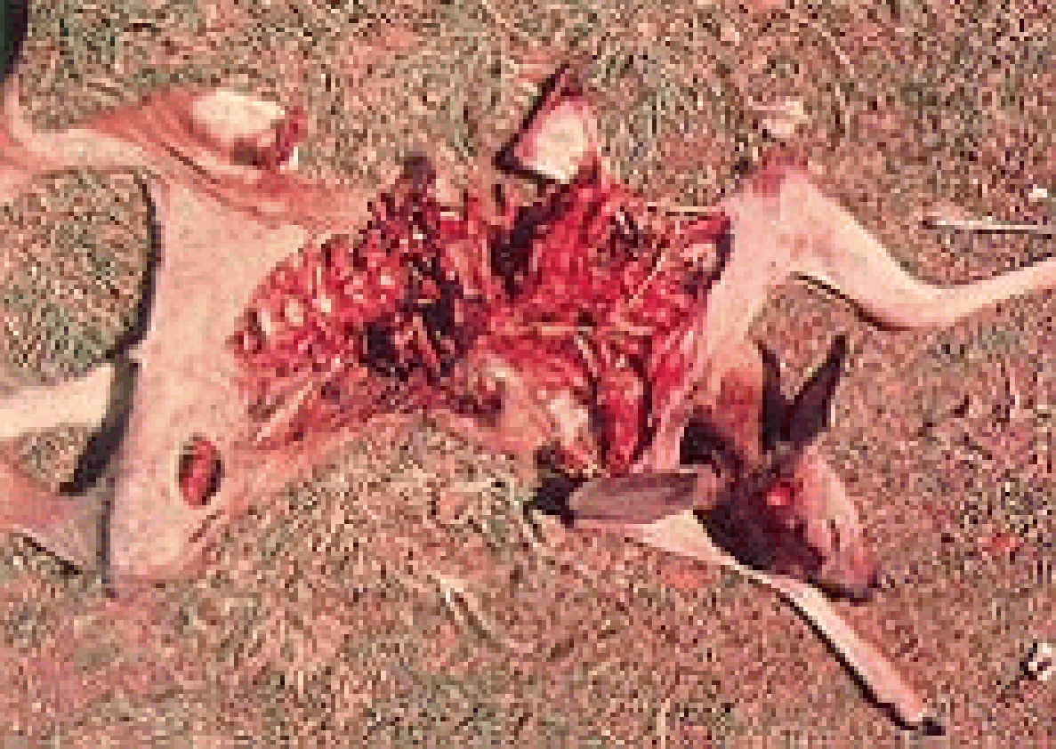
Impacts of Predation Laws on Wyoming Land Owners
Legislative Overview
Key Dates - Federal
Coyote Depredation
1886: USDA creates agency
  Program focuses on bird damage/control
1913: Direct control begins on rodents
1914: Direct control begins on predators
1931: Animal Damage Control Act of 1931

Slide 3
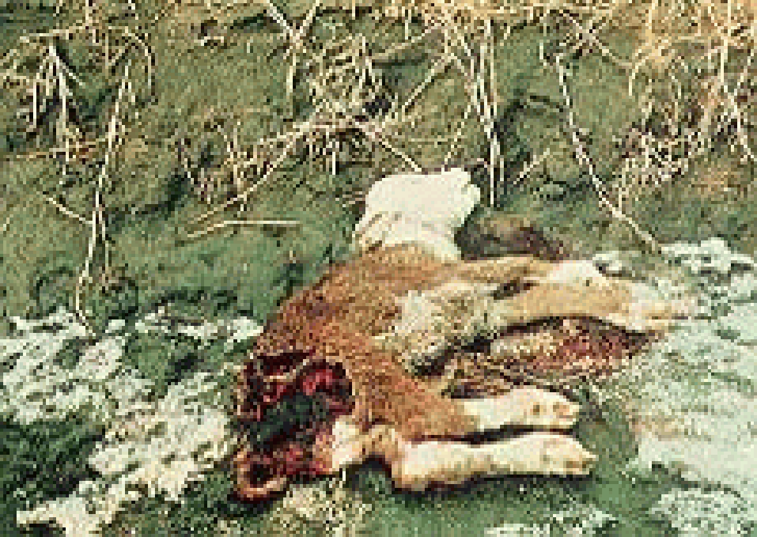
Impacts of Predation Laws on Wyoming Land Owners
Legislative Overview
Key Dates - Federal
Coyote Depredation
1939: USDA transfers authority to FWS
1956: Federal Airborne Hunting Act passed
1964: Leopold Report released
1972: Cain Report published
  Calls for a ban on poison use - Nixon signs order

Slide 4
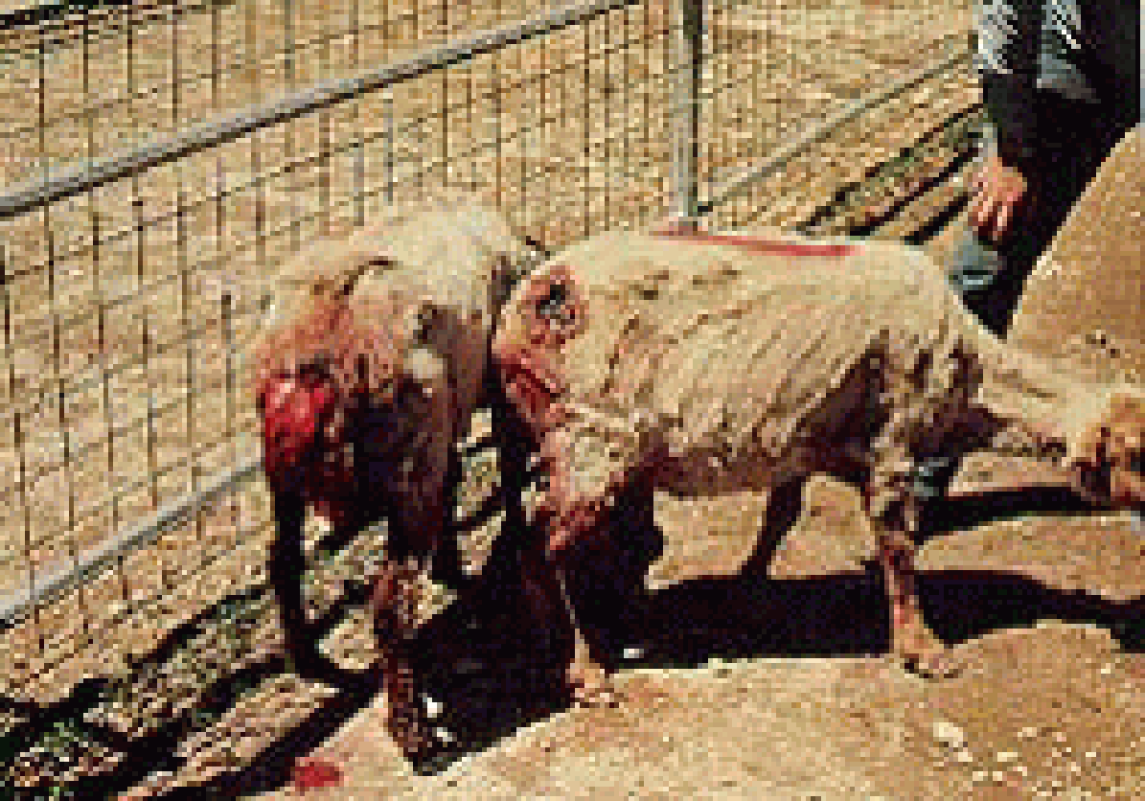
Impacts of Predation Laws on Wyoming Land Owners
Legislative Overview
Key Dates - Federal
Dog Depredation
1973: Endangered Species Act passed
1975: President Ford repeals Nixon's order
  Allows M-44 use, WY receives M-44 registration
1979: Secretary of Interior Andrus orders ban on denning, 1080 research & use. ADC issues first Environmental Impact Report

Slide 5
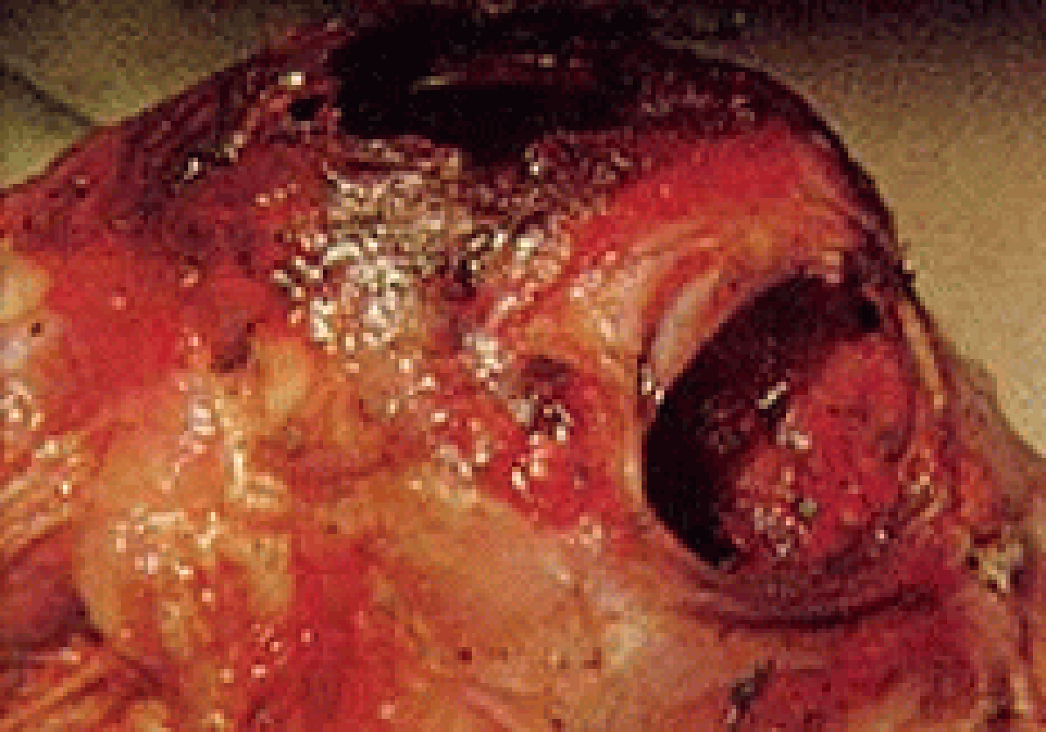
Impacts of Predation Laws on Wyoming Land Owners
Legislative Overview
Key Dates - Federal
Eagle Depredation
1981: Secretary of Interior James Watt rescinds ban on denning. President Reagan revokes Nixon's ban on poisons
1986: Legislation transfers ADC from FWS back to USDA
1993: EIS issued. ADC now Wildlife Svs.

Slide 6
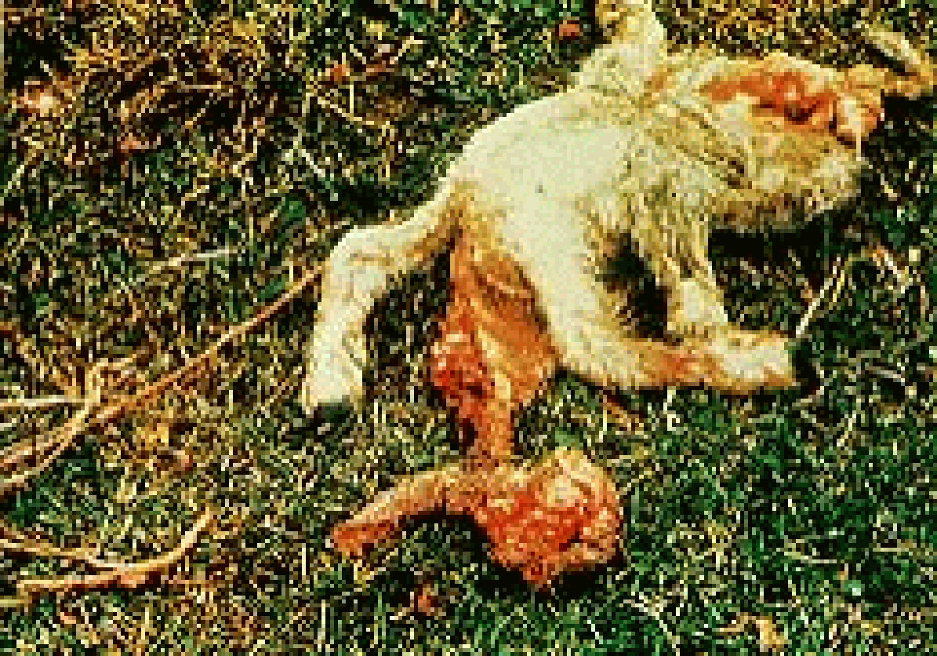
Impacts of Predation Laws on Wyoming Land Owners
Legislative Overview
Key Dates - State
Raven Depredation
1869: Legislation regulating sale or giving away of poisons
1875: "An Act for the protection of sheep"
  Authorized county commissioners to pay bounties on wolves
  Bounty funding trend lasted until 1941

Slide 7
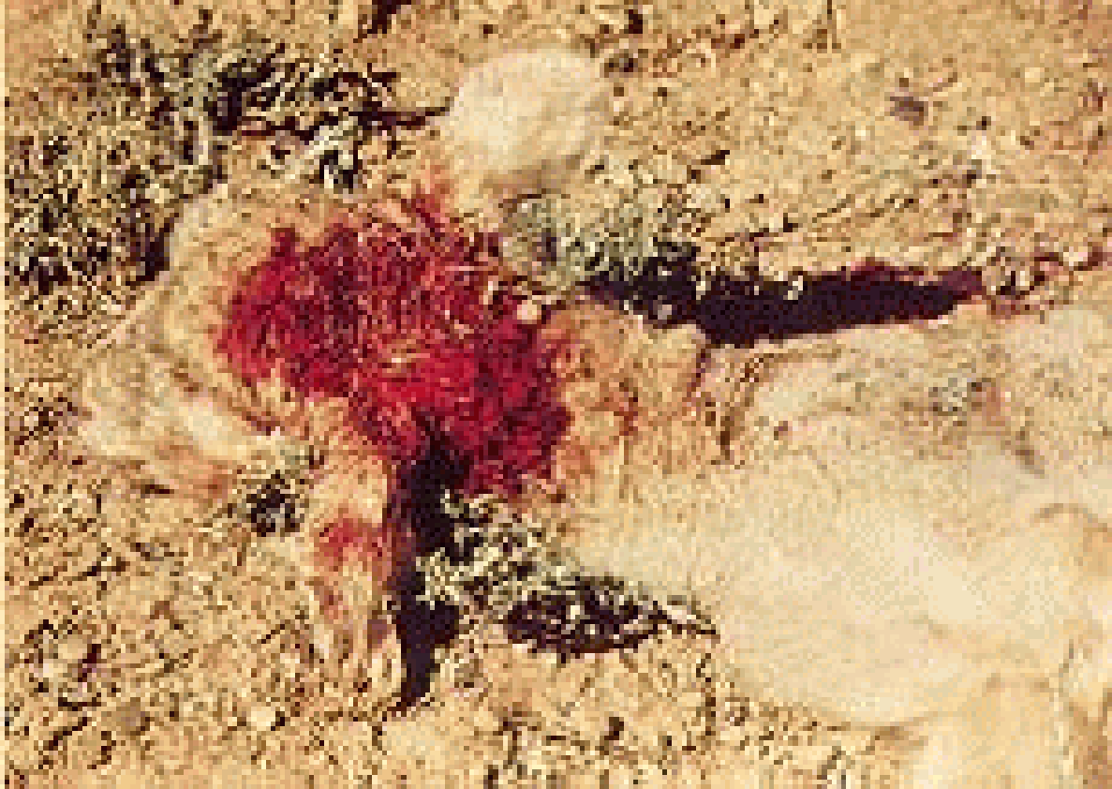
Impacts of Predation Laws on Wyoming Land Owners
Legislative Overview
Key Dates - State
Coyote Depredation
1882: First game law enacted
1890: WY becomes a state. Constitution provides for protection of livestock
1921: Legislation creates funded budgets for rodent/predator management

Slide 8
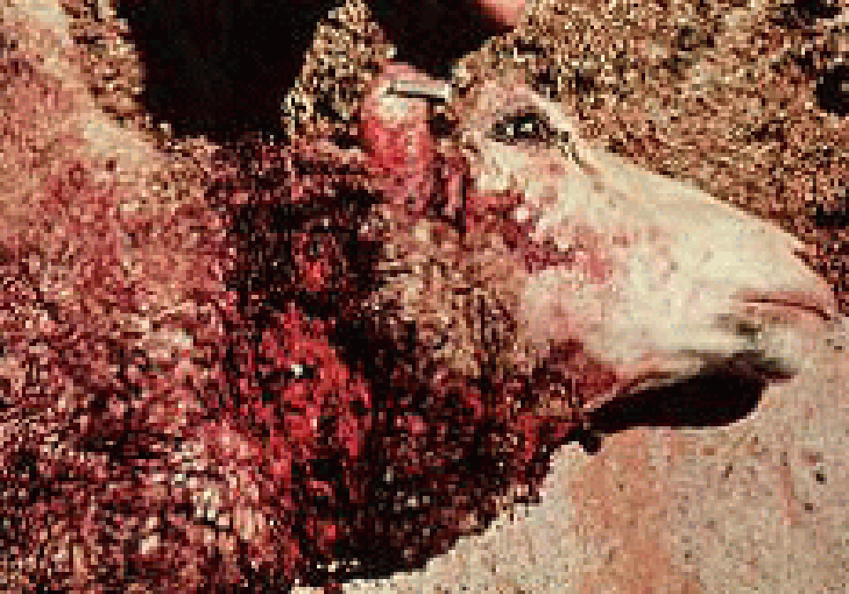
Impacts of Predation Laws on Wyoming Land Owners
Legislative Overview
Key Dates - State
Dog Depredation
1937: Legislature defines predatory animals in the Wyoming Game & Fish Laws
1943: Predatory Animal Districts formed and mill levy funding established
1953: WDA authorized to be lead agency in predator management

Slide 9
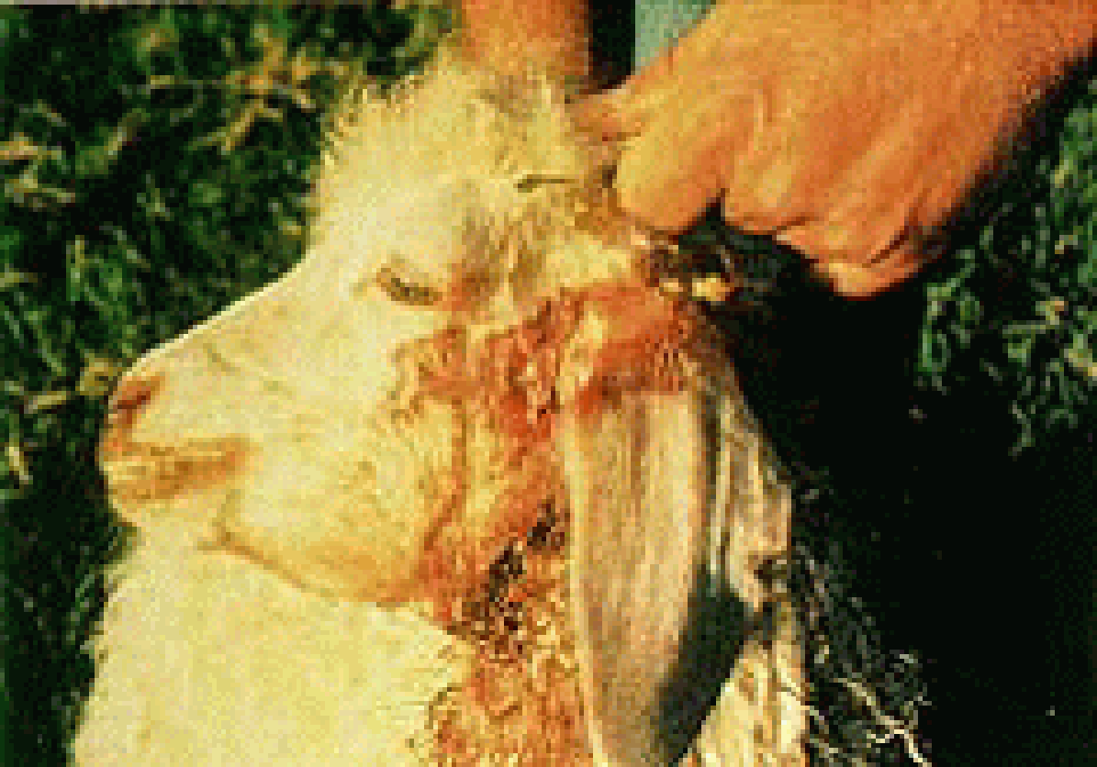
Impacts of Predation Laws on Wyoming Land Owners
Legislative Overview
Key Dates - State
Fox Depredation
1967: Gray wolf listed as endangered
1973: Legislature authorizes issuance of aerial hunting permits; amended WDA responsibilities; created the WY Environmental Pesticide Control Act; amended predatory animal definitions

Slide 10
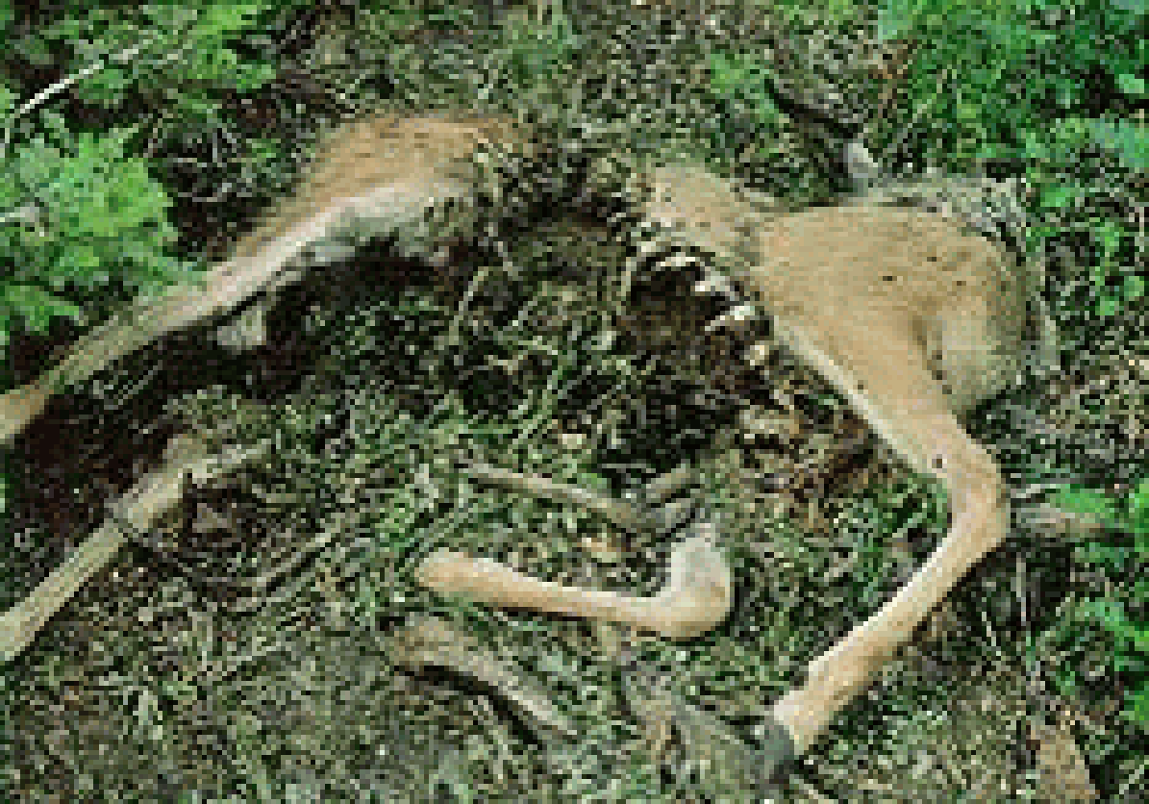
Impacts of Predation Laws on Wyoming Land Owners
Legislative Overview
Key Dates - State
Mountain Lion Depredation
1976: WY receives full EPA registration for use of the M-44
1977: Predatory Animal Law amended to provide for taxation of both cattle & sheep
1978: EPA sues WDA over use of 1080 baits

Slide 11
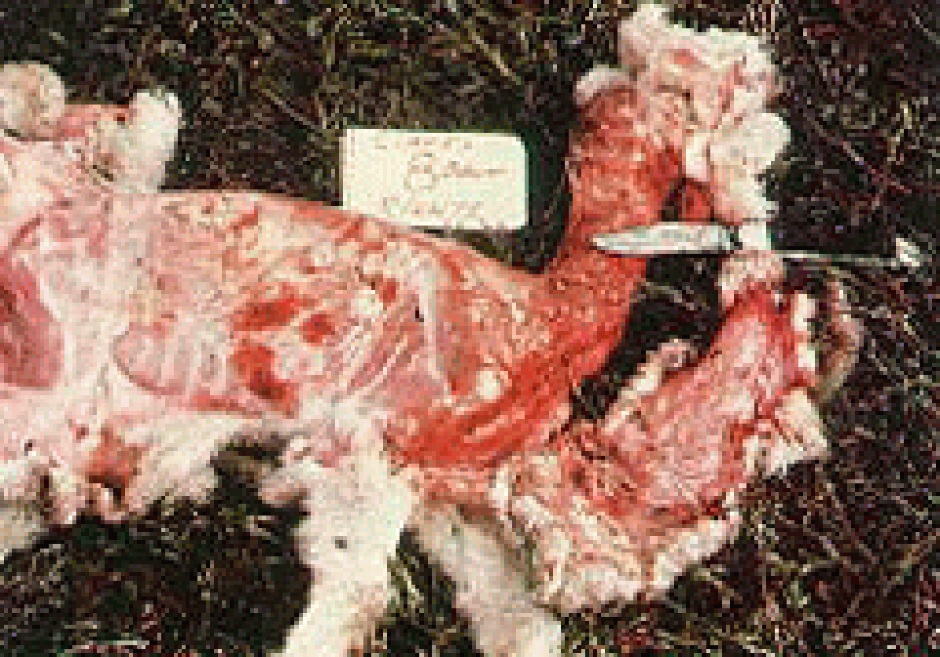
Impacts of Predation Laws on Wyoming Land Owners
Legislative Overview
Key Dates - State
Bobcat Depredation
1985: WY receives EPA registration for the Livestock Protection Collar
1988: ADC personnel transferred from WDA to USDA
1990: Mill levy repealed, per head assessment created; entire PC law amended

Slide 12
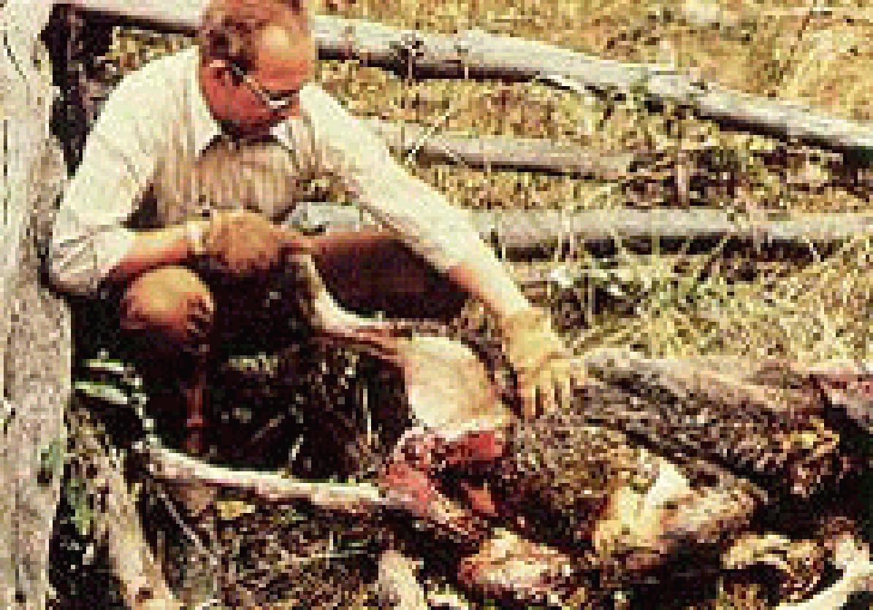
Impacts of Predation Laws on Wyoming Land Owners
Legislative Overview
Key Dates - State
Black Bear Depredation
1991: WY Legislatures issues resolution opposing wolf re-introduction
1991, >92, >93, & >94: Predator Law amended each of these years
1995:Canadian gray wolves re-introduced into Yellowstone National Park

Slide 13
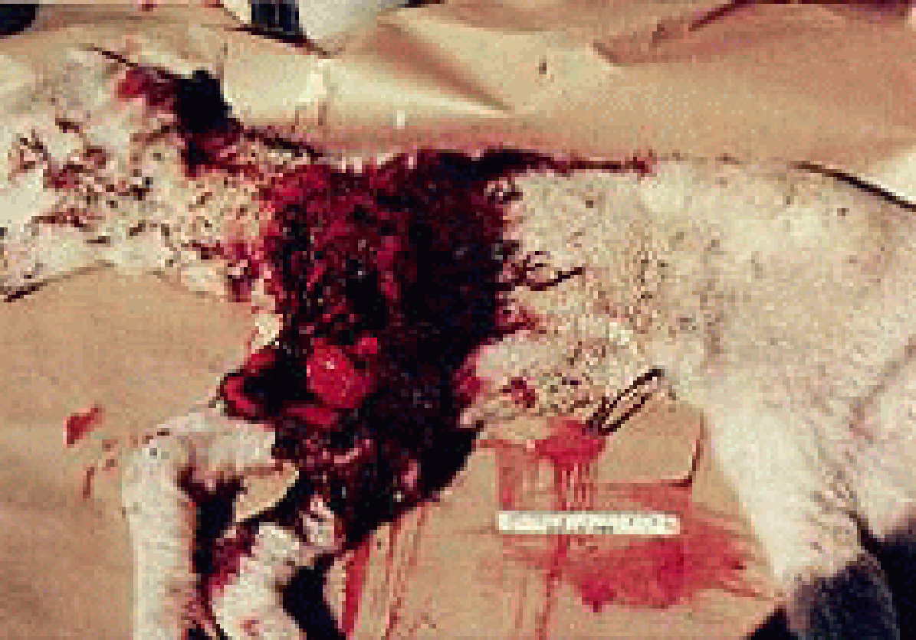
Impacts of Predation Laws on Wyoming Land Owners
Legislative Overview
Key Dates - State
Hawk Depredation
1997: WY Farm Bureau sues FWS over wolf re-introduction; Court rules in favor of WFB, but stays removal order; Game & Fish issues the state wolf management plan
1999: Legislature forms the WY Animal Damage Management Board

Slide 14
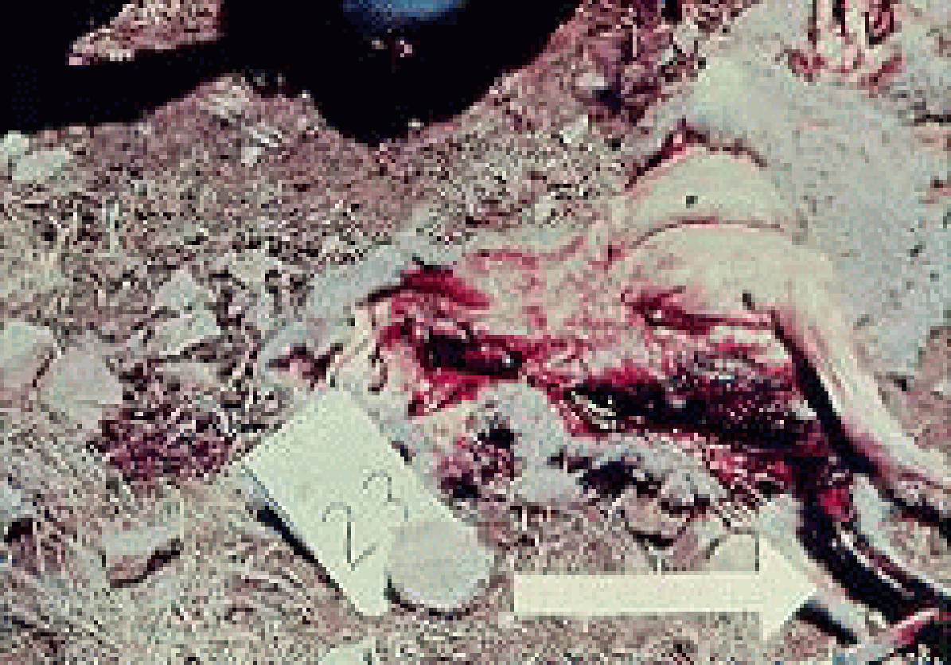
Impacts of Predation Laws on Wyoming Land Owners
Legislative Overview
Key Dates - State
Rattlesnake Kill
2000: WY G&F begins process for Grizzly Bear Management plan
2002: Predatory Animal Control Law amended; WY ADMB statutes amended to direct the board to establish a rabies management program

Slide 15
Key Dates Cont.
2006: Funding for PMDs passed.
2008: The state’s management plan is accepted by the FWS and wolves are delisted temporarily.
2012: Gray wolves again delisted and State funding made available for wolf management in the predatory area.

Slide 16
Impacts of Predation Laws on Wyoming Land Owners
Methods of Management
Integrated
Non-Lethal
Lethal
Issues

Slide 17
Impacts of Predation Laws on Wyoming Land Owners
Methods of Management
Non-Lethal
Livestock Husbandry
Padded traps
Foot Snares
Guard Animals
  Dogs, Llamas, Donkeys
Annoying Sounds
Conventional/Electrical Fencing

Slide 18
Impacts of Predation Laws on Wyoming Land Owners
Methods of Management
Lethal
Aerial Hunting
Calling & Shooting
Denning
Traps
Snares
Fumigants/Poisons
  Denning Cartridges, M-44s, LPC

Slide 19
Impacts of Predation Laws on Wyoming Land Owners
Methods of Management
Issues
Animal Rights
Environmental Interests
Public Perception - Media - Enemy #1
  Information, Misinformation
Public Land Grazing
Management on Public versus Private Land

Slide 20
Impacts of Predation Laws on Wyoming Land Owners
Methods of Management
Issues
Restrictions on Methods
Resource Limitations
  Funding, Method Cost Efficiency
Roles/Policies of entities/agencies
Loss of fur markets/incentives
  EU Ban on furs
GATT (General Agreement of Taxes and Tariffs)

Slide 21
Impacts of Predation Laws on Wyoming Land Owners
Methods of Management
Issues
ESA: T&E Species, Listings, Species of Special Concern
NEPA
Migratory Bird Act
Bald Eagle Protection Act
FIFRA - EPA

Slide 22
Impacts of Predation Laws on Wyoming Land Owners
Methods of Management
Issues
National Historical Preservation Act
Airborne Hunting Act
Presidential Orders
WY Predatory Animal Control Law
WY Airborne Hunting Regulations
WY Game & Fish Statutes/Regulations

Slide 23
Impacts of Predation Laws on Wyoming Land Owners
Methods of Management
Issues
Compensation
  None to Little
    Statute Definition as predator versus big game/trophy
    Previously Defenders of Wildlife for Wolves
  No "Insurance Policies"
  Confirmed versus Actual Losses
  G&F compensation for trophy area
Limited Research
  NWRC, UW

Slide 24
Impacts of Predation Laws on Wyoming Land Owners
Methods of Management
Issues
Intensity of predator management
  Cattle versus sheep
  Prey versus predator
Wildlife
  Benefits of predator control
Whose Authority?
  Ranching/Livestock, Urban, Government, Public at large

Slide 25
Impacts of Predation Laws on Wyoming Land Owners
Methods of Management
Agency Roles
USDA
WDA
WY G&F
WY Predatory Animal Advisory Board
County Predator Boards
BLM & FS
USFWS
WY ADMB

Slide 26
Impacts of Predation Laws on Wyoming Land Owners
Methods of Management
QUESTIONS?
Kent Drake
Wyoming Dept. Of Agriculture
6607 Campstool Road
Cheyenne, WY 82002-0100
Phone: 307-777-6781
kent.drake@wyo.gov

