Slide 1
Coyote Damage Management
Using the M-44
Jerry Johnson
Wyoming Department of Agriculture
Predator Management Coordinator

Slide 2
Basic Information
Coyotes

Slide 3
Basic Information
Coyotes
Principle predator of sheep and increasingly on calves
Population increases most when large % of both sexes are more than seven years old
Known animals of habit
  Set M-44s along known trails

Slide 4
Basic Information
Coyotes
Acute sense of smell, eyesight, hearing and are extremely adaptable
Kill:
  What they need to survive
  More than what they need to survive
  Excessive numbers of prey when feeding pups
  And without ever feeding on the prey
  Generally kill by biting the prey's head and/or neck

Slide 5
Basic Information
The M-44 Device

Slide 6
Basic Information
M-44 History
1967 – M-44 was adopted as a replacement for the Coyote Getter
1972 - Nixon banned all uses of the M-44
1974-75 EPA issued 9 experimental use permits for research
Sept. 16, 1975 EPA issued full registration for M-44, but placed 26 Restrictions on its use, now 27 restrictions.
May 28 1976 President ford issued executive order 11917 which allows only federal employees to use M-44’s on Federal Lands.

Slide 7
Basic Information
M-44 General Overview
Applicators are required by EPA to receive specialized training
Private or Commercial Applicator certification is based upon occupation
  Private: Landowner or ranch employee
    Use on neighbors property w/o compensation
  Commercial: Payment for hire
    Integral part of employment
    Use on property not owned by the applicator

Slide 8
Basic Information
M-44 General Overview
The Federal Insecticide, Fungicide, & Rodenticide Act, (FIFRA), and the Wyoming Environmental Pesticide Control Act, (WEPCA) requires that all pesticide products be classified as either “General” or “Restricted use”. General use can be used by the general public, while only applicators who are certified may use Restricted use pesticides.

Slide 9
Basic Information
M-44 General Overview
Restricted Use pesticides are generally those products which pose a hazard to the applicator or which, if used improperly, could cause environmental damage. EPA and Wyoming recognize that even extremely toxic pesticides can be used safely if the applicator is trained in pesticide use and follows the label Directions.

Slide 10
Basic Information
M-44 General Overview
Wyoming has a program designed to meet EPA requirements which will provide certification for anyone desiring to use a RESTRICTED USE pesticide product. The M-44 Sodium Cyanide Capsules are a RESTRICTED USE , and can only be applied by persons who are certified applicators. CORRECT USE OF THE RESTICTED USE PESTICIDE IS THE RESPONSIBITY OF THE APPLICATOR.

Slide 11
Basic Information
M-44 General Overview
Non-Government Applicators are allowed to place devices on private & state land only.
Send form to OSLI Cheyenne if on State lands
Only trained and certified:
  Private
  Commercial
  Non-Government
  Government
Applicators may purchase and use
Sodium Cyanide Capsules

Slide 12
Basic Information
M-44 General Overview
Summer months - least effective
Fall and Winter - most effective
Expulsion of cyanide is by a spring & plunger
  Reduces initial alarm
  Closer recovery of animal

Slide 13
Basic Information
M-44 General Overview
More selective to canines than cats
  Due to behavior
  Response to carrion
  Method of accepting food
Dogs, coyotes, foxes all can be taken with M-44
  Occasionally bobcats will pull

Slide 14
Basic Information
M-44 General Overview
The device may misfire due to:
  Moisture
  Temperature
  Design
  Affects the ejection of the cyanide
The M-44 will kill or injure humans if the proper precautions are not taken

Slide 15
Basic Information
Sodium Cyanide

Slide 16
Basic Information
Sodium Cyanide
Restricted-Use Pesticide
Each capsule contains:
  Sodium Cyanide -Approximately 1 Gram or 15 Grains
    Inert Marking Agent
      Yellow Day-Glo Marker
      Aids in kill determination, will fluoresce under UV light
      USDA Wildlife Services Marking Agent is Orange
Acute-single dose toxicant

Slide 17
Basic Information
Sodium Cyanide
Sodium Cyanide forms hydrocyanic acid (HCN) when in contact with:
  Water, saliva, weak acids, perspiration
Most rapidly acting predacide
Offers lowest secondary poisoning hazard to non-targets. Lethal dose for coyotes is:
  20-30 mg/kg
  Approximately 300 mg for a 33 pound coyote

Slide 18
Basic Information
Sodium Cyanide
As with any pesticide, when handling, applicators should wear:
  Long sleeved shirt and pants
  Shoes plus socks
  Waterproof gloves, and
  A full face shield or other mechanism to contain and/or deflect ejected material away from the face of the applicator
  Do not look directly over the device when setting/inspecting/servicing
  Keep wind to your back
  Hand cupped over the device

Slide 19
Basic Information
Sodium Cyanide
As with any pesticide, when handling, applicators should wear:
  Long sleeved shirt and pants
  Shoes plus socks
  Waterproof gloves, and
  A full face shield or other mechanism to contain and/or deflect ejected material away from the face of the applicator
  Do not look directly over the device when setting/inspecting/servicing
  Keep wind to your back
  Hand cupped over the device

Slide 20
Sodium Cyanide
Toxic Effects
Three routes of intoxication:
  Inhalation
  Ingestion
  Absorption
Affects the cellular activities:
  Prevents utilization of oxygen at the cellular level

Slide 21
Sodium Cyanide
Toxic Effects
Lethal Dose: Inhalation or ingestion
  Unconscious in a few seconds
  Rapid breathing, slowing to low and gasping
  Convulsions may or may not occur
  Coma and death within minutes

Slide 22
Sodium Cyanide
Toxic Effects
Sub-lethal Dose: Absorption
  Weakness
  Dizziness
  Confusion
  Headache
  Vomiting
  Coma
  Convulsions may or may not occur

Slide 23
Sodium Cyanide
First Aid
PROMPT TREATMENT IMPORTANT
Call poison control center or physician immediately
  1-800-222-1222

Slide 24
Sodium Cyanide
First Aid
PROMPT TREATMENT IMPORTANT
If swallowed:
  Call poison control center or doctor immediately
  1-800-222-1222
  Rinse mouth with water
  Remove contaminated clothing but keep patient warm
  Do not induce vomiting unless told to by poison control center or doctor
  Do not give anything to an unconscious person

Slide 25
Sodium Cyanide
First Aid
PROMPT TREATMENT IMPORTANT
If inhaled:
  Move person to fresh air, have him lie down.
  If person is not breathing, call 911, then give artificial respiration.
  Call a poison control center or doctor for further treatment advice. 1-800-222-1222

Slide 26
Sodium Cyanide
First Aid
PROMPT TREATMENT IMPORTANT
If on skin:
  Take off contaminated clothing.
  Rinse skin immediately with plenty of water for 15-20 minutes.
  Call a poison control center or doctor for further treatment advice. 1-800-222-1222

Slide 27
Sodium Cyanide
First Aid
PROMPT TREATMENT IMPORTANT
If in eyes:
  Hold eye open and rinse slowly and gently with water for 15-20 minutes. Remove contact lenses, if present, after the first 5 minutes, then continue rinsing eyes.
  Call a poison control center or doctor for further treatment advice. 1-800-222-1222

Slide 28
Sodium Cyanide
First Aid
PROMPT TREATMENT IMPORTANT
Do not:
  Give alcohol
  Use snow on face
  Use eye wash unless prescribed by physician

Slide 29
Handling and Storage
Capsules
Do Store in a locked, marked box
Do not store with human food or livestock feed
Capsules are very susceptible to heat damage
  Store at room temperature or where the temperature stays fairly constant
  Capsules deteriorate faster with wide temperature fluctuations

Slide 30
Handling and Storage
Capsules
Store capsules in an airtight container with moisture absorbing desiccant
Capsules sealed with petroleum hydrocarbon wax
Keep capsules out of sunlight and away from heat

Slide 31
Handling and Storage
Capsules
Take only enough capsules that you will need that day
Do not keep capsules in the glove box, floor board or where extreme temperatures occur
The label on each capsule MUST REMAIN on the capsule

Slide 32
Handling and Storage
Capsules
New capsules, or capsules that have been in storage should be inspected for the following prior to using:
Caking:
Tip capsules back and forth
Contents should be free flowing
Sticking or clumping - contents is caking
Test fire if necessary

Slide 33
Handling and Storage
Capsules
Overfull:
Capsules have air space of 1/10 inch
Cyanide expands when exposed to water
Overfull capsules likely exposed to moisture
Will be partly caked

Slide 34
Handling and Storage
Capsules
Age:
Check the date of manufacturer on box
Purchase what you will use in 6 months
Older capsules are more likely to be defective

Slide 35
Handling and Storage
Capsules
Flare or Swelling:
Caused by chemical reaction between wax sealant and plastic
Reaction accelerated by heat
Capsules should slide in easily into holder, if not the capsule may be flared and defective

Slide 36
Handling and Storage
Ejectors
Lubrication and Cleaning:
Ejectors need to be kept cleaned & lubricated
Suggested lubricants: silicone spray, mineral oil, food machinery lubricants. Glycerine is not recommended

Slide 37
Handling and Storage
Ejectors
Lubrication and Cleaning:
Cyanide is extremely corrosive
Once fired, any cyanide should be removed with a wire brush and lubricated
Current ejectors use a retaining pin to hold the spring in place. This can be removed for further cleaning and lubricating

Slide 38
Handling and Storage
Ejectors
Frequency of Servicing:
Set M-44s should be lubricated and reset at least once a month if they haven't been pulled
You may also carefully test fire some to assure proper functioning

Slide 39
Handling and Storage
Ejectors
Trigger Pull Force:
New ejectors have a stronger pull force
To reduce trigger pull:
Set the trigger at a right angle to the ejector
Lubricate the trigger and plunger
Dry fire the ejector against a wood scrap

Slide 40
Handling and Storage
Stakes
Driving Stakes:
Never hammer on the stake, use a driving rod inside the stake
In hard soil, make a pilot hole first with the driving rod or a 3/4" Drill

Slide 41
Handling and Storage
SAFETY FIRST! AVOID Accidental Discharge
Always wear full face shield to contain and/or deflect material away from your face
Never put yourself in a position where the cyanide will hit you in the face or eyes
Work sideways to the wind or with the wind at your back. Do not kneel or stand over the device
While servicing, place a plastic bag or thumb from a glove over the capsule holder to confine any cyanide

Slide 42
Application of the
M- 44
Selecting the Site

Slide 43
Selecting the Site
Plan your application strategy
  What type of set to make? Above ground or recessed
Knowledge of the coyotes habits in the area increases success
  Coyotes tend to use the easiest & most convenient route such as livestock trails.
  Set the device off to the side of the trail, never on it

Slide 44
Selecting the Site
Mark the pastures w/ required signs
Use a lure made for the M-44
  Biting/chewing response
  Change lures if no response
Use caution when setting, leave as little of your own odor as possible
Draw stations & bone piles help
Be sure to follow the 27 use restrictions

Slide 45
Additional Suggestions
M-44

Slide 46
Additional Suggestions
Keep prepared holders, ejectors & stakes in separate containers
Use one pair of gloves for setting M-44s, another pair for other ranch duties
Limit leaving signs of your presence/odor
Coyotes often visit M-44s, roll on it and return again before pulling
  If sign of visit is present, leave device alone

Slide 47
Additional Suggestions
If no target predator has visited the site for 30 days and losses continue:
  Relocate the M-44 to another site
  Change lures & holders
Recovery distance of the target predator varies dependent upon the quality of the capsule used
  Typical recovery is within eyesight of the device

Slide 48
Additional Suggestions
Dog training capsules available
  Use same lure(s) as those you are using in the field
Removing devices:
  To disarm, cover the holder with gloved hand
  PUSH DOWN and unscrew the holder from the ejector
  Remove device
  Remove stake and gate signs

Slide 49
Purchasing Requirements
M-44

Slide 50
Purchasing Requirements
Order Form
Record of Livestock Loss
  Must be documented prior to application of the device
Delivery of Sodium Cyanide & Hardware
  Sodium Cyanide can be surface mailed only
  New Requirements for paying for order

Slide 52
Record Keeping Requirements
M-44

Slide 53
Record Keeping
Wyoming has a monthly reporting requirement and a new requirement that you notify WDA ASAP or within 14 days of placement with a GPS location. NEW FORM
No report necessary if no devices are in use
Rule of thumb is: Document everything

Slide 54
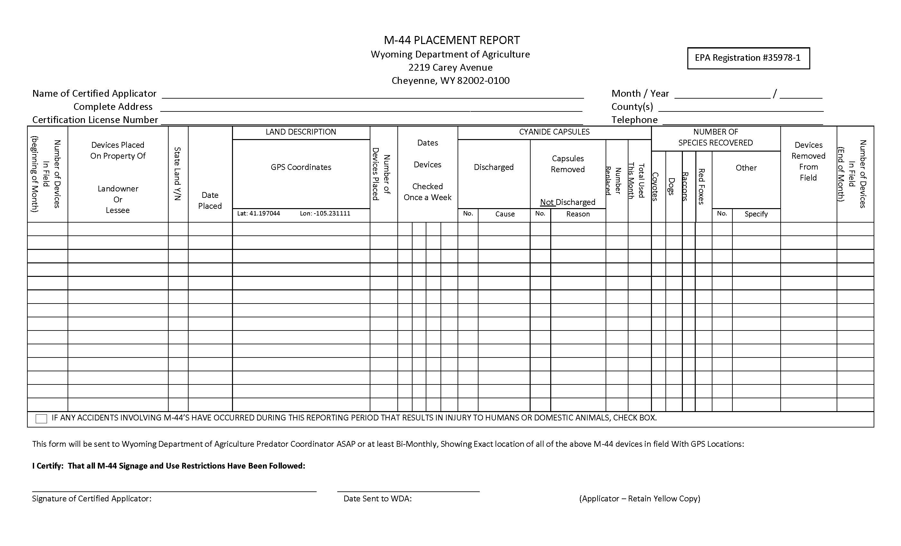

Slide 55
If placing M-44s on State lands
Mark which M-44 locations were set on State lands on the Form
Send placement form copy to:
Office of State Lands and Investments
Field Services Division
Attn. Ben Bump
Herschler Building, Suite W103
122 W. 25th Street
Cheyenne, WY 82002

Slide 56
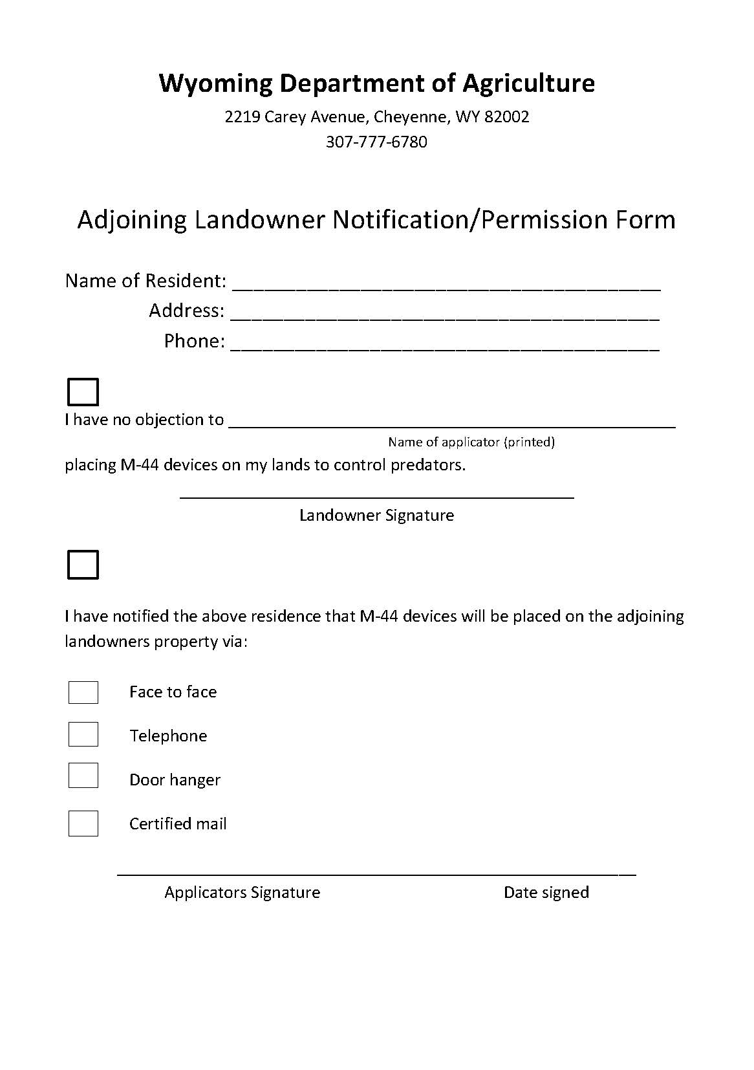

Slide 57
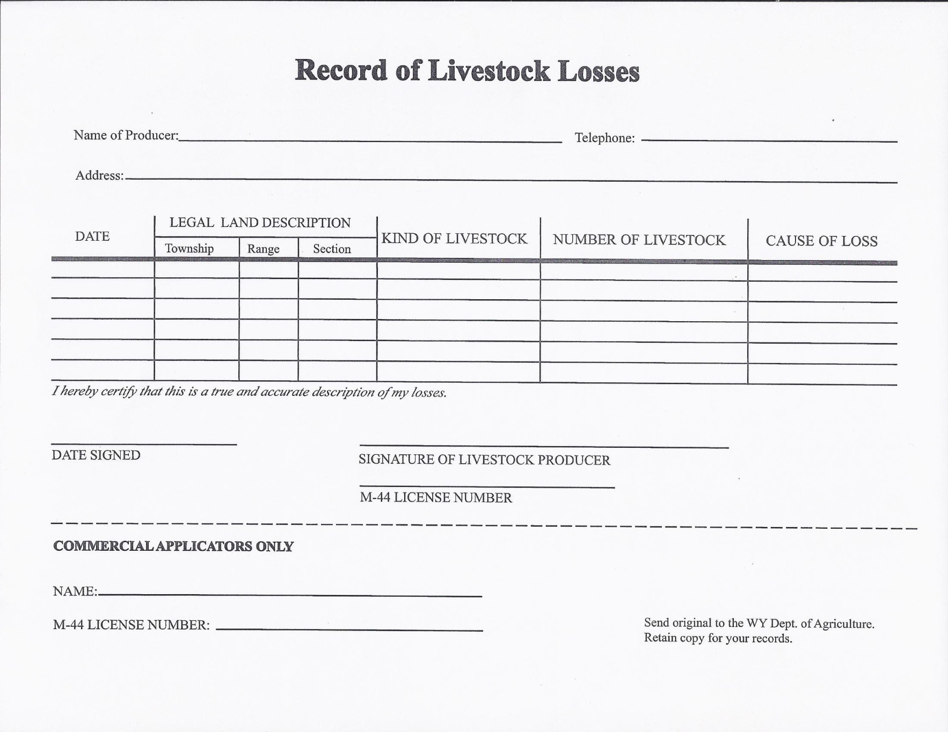

Slide 58
Record Keeping
Everything on the reporting form must be completed to meet EPA requirements
Record of Livestock Loss must be completed
Adjoining Landowner
Permission/Notification Form

Slide 59
Record Keeping
Usual and customary information:
  Name, address, license number #
Records must include but not limited to:
  Number of devices placed
  Location of each device by GPS
  Date of placement & inspection, and date of removal
  Number discharged & reason for discharge
  Species of animals taken
  Any accidents to humans/domestic animals

Slide 60
Record Keeping
In addition, document the following on the M-44 report:
  Size of treatment area
  Method of disposal
Records must be kept by the applicator for a minimum of two years

Slide 61
Record Keeping
Review of forms:
  Monthly Report
  Exact placement form – ASAP or within 14 days
  Record of Livestock Loss
  Order Form
  Adjoining Landowner Permission/Notification Form

Slide 62
EPA Use Restrictions
M-44

Slide 63
Use Restrictions
1. Use of the device must conform to all applicable Federal, State, and Local laws and regulations.

Slide 64
Use Restrictions
2. Applicators must be subject to such other regulations and restrictions as may be prescribed from time-to-time by the U.S. Environmental Protection Agency (EPA).

Slide 65
Use Restrictions
3. Each applicator of the M-44 must be trained in:
  (1) safe handling of the capsules and device,
  (2) proper placement of the device, and
  (3) necessary record keeping.

Slide 66
Use Restrictions
4. M-44 devices and sodium cyanide capsules must not be sold or transferred to, or entrusted to the care of any person not supervised or monitored, by the Wyoming Department of Agriculture.

Slide 67
Use Restrictions
5. The M-44 device must only be used to take wild canids:
  (1) suspected of preying on livestock and poultry,
  (2) suspected of preying on Federally designated threatened or endangered species, or
  (3) that are vectors of a communicable disease.

Slide 68
Use Restrictions
6. The M-44 device must not be used solely to take animals for the value of their fur.

Slide 69
Use Restrictions
7. The M-44 device must only be used on or within 7 miles of a ranch unit or allotment where losses due to predation by wild canids are occurring or where losses can be reasonably expected to occur based upon recurrent prior experience of predation on the ranch unit or allotment

Slide 70
Use Restrictions
7. (Continued) - Full documentation of livestock depredation, including evidence that such losses were caused by wild canids, will be required before applications of the M-44 are undertaken.
  This restriction is not applicable to government-run programs in which wild canids are controlled to protect Federally designated threatened or endangered species or are vectors of a communicable disease.

Slide 71
Use Restrictions
8. The M-44 device must not be used: (1) on Federal lands set aside for recreational use, (2) in areas where exposure to the public and family or pets is probable, (3) in prairie dog towns, or (4) in National or State Parks; National or State Monuments; federally designated wilderness areas; and wildlife refuge areas, except that the M-44 device may be used in the areas listed above in (4) only for the protection of Federally designated threatened or endangered species.

Slide 72
Use Restrictions
8. (continued) To determine whether the applicable land management agency has set aside any area on Federal Lands for recreational use either on a permanent or temporary basis, the APHIS State Director or his/her designated representative who are considering authorizing or are responsible for ongoing use of M-44 capsules on public lands, must contact each applicable land management agency quarterly to determine whether any portions of the projected or current M-44 use areas are, or are to be, set aside for recreational use. Within 30-days of that contact, the APHIS State Director, or his/her designated representative, must provide the applicable land management agency with written documentation specifying the applicable land management agency’s determinations of what projected or current M-44 use areas are to be set aside for recreational use. For purposes of this Use Restriction, areas set aside for recreational use include areas where and when there are scheduled recreational events, areas identified on maps with “recreation” in the title, areas where developed or known camping occurs, areas near designated or known recreational trail heads and designated or known vehicle access sites. For State lands in Wyoming, the Wyoming Department of Agriculture M-44 applicator supervisor will consult with the director, of his or her designee of the Wyoming State Office of Lands and Investments, regarding land management and licensed M-44 use.

Slide 73
Use Restrictions
9. The M-44 devices must only be used in areas where either 1) Federally endangered or threatened species under the Endangered Species Act (“endangered or threatened species”) are not expected to be exposed to the devices or the pesticide contained in the devices, or

Slide 74
Use Restrictions
9.(continued) 2) where site- and/or species-specific measures have been prepared by or in coordination with the U.S. Fish and Wildlife Service (“Service”) that will avoid endangered or threatened species’ exposure to such devices or the pesticide contained in them. At the time of application, each applicator must have in their possession a list of threatened and endangered species (“species list”), not more than 3 months old, from the Service that may be present within the area in which M-44 devices are to be deployed. Species lists and Service points of contact are available through the Information, Planning and Consultation (IPaC) website (https://ecos.fws.gov/ipac/).

Slide 75
Use Restrictions
9.(continued) To procure an official species list, the geographic area in which M-44 devices are to be deployed must be entered into IPaC. Each applicator must ensure that one of the following conditions are met: 1) there are no endangered or threatened species shown on the species list for the area in which M-44 devices are to be deployed that can trigger the device or can scavenge on carcasses impacted by the device; or 2) if endangered and threatened species capable of triggering the device or scavenging on carcasses impacted by the device are shown on the species list, the applicator must also have in their possession written documentation of any appropriate site- and/or species-specific measures that avoid exposure and are prepared by or developed in coordination with the Service.

Slide 76
Use Restrictions
9.(continued) Website to access map
(IPaC) website (https://ecos.fws.gov/ipac/).
Go to website set up account
Click Get started –
enter location ex. Park, county Wyoming
Click Define project Ex. Set M-44’s for predator control for Park County Predator Board.
Download list of species. (There may not be any)

Slide 77
Use Restrictions
10. At least one person within WDA in addition to the individual applicator must have knowledge of the exact placement of all M-44 devices in the field. This includes initial placement and any subsequent changes of M-44 GPS locations as soon as possible but no later than 14 days. In the case of applications to privately owned land, the applicator must also have written permission from the landowner or lessee who has requested M-44 device use prior to their placement. When devices are placed on private land, all residences on the property must be notified of the M-44 device use.

Slide 78
Use Restrictions
11. In areas where more than one governmental agency is authorized to place M-44 devices, the agencies must exchange placement information and other relevant facts to ensure that the maximum number of M-44’s allowed is not exceeded.

Slide 79
Use Restrictions
12. The M-44 device must not be placed within 200 feet of any nonfrozen lake, stream, or other body of water; provided that natural depression areas which catch and hold rainfall for short periods of time shall not be considered “bodies of water” for purposes of this restriction. M-44 devices may be set within 200 feet of frozen bodies of water only if (i) they are removed before the water body is no longer completely frozen, and (ii) are set at such elevation to prevent inundation in the event of an untimely thaw.

Slide 80
Use Restrictions
13. The M-44 device must not be placed in areas where food crops are planted.

Slide 81
Use Restrictions
14. The M-44 device must not be placed within 300 feet of any designated public road or public pathway.

Slide 82
Use Restrictions
15. The maximum density of M-44’s placed in any 100-acre pasture land areas must not exceed 10; and the density in any 1 square mile of open range shall not exceed 12.

Slide 83
Use Restrictions
16. M-44 devices must not be placed within 30 feet of a livestock carcass used as a draw station. No more than four M-44 devices may be placed per draw station and no more than five draw stations may be operated per square mile.

Slide 84
Use Restrictions
17. Supervisors of applicators must check the records, warning signs, and M-44 devices of each applicator at least once a year to verify that all applicable laws, regulations, and restrictions are being strictly followed.

Slide 85
Use Restrictions
18. Each M-44 device must be visually inspected by the applicator at least once every week, weather permitting access, to check for interference or unusual conditions; and must be serviced as required, by the applicator.

Slide 86
Use Restrictions
19. Damaged or nonfunctional M-44 devices must be removed from the field.

Slide 87
Use Restrictions
20. An M-44 device must be removed from an area if, after 30 days, there is no sign that a target predator has visited the site.

Slide 88
Use Restrictions
21. All persons authorized to possess and use sodium cyanide capsules and M-44 devices must store such capsules and devices under lock and key, including when in transit.

Slide 89
Use Restrictions
22. Used sodium cyanide capsules must be disposed of by deep burial or at a proper landfill site. Incineration may be used instead of burial for disposal. Place the capsules in an incinerator or refuse hole and burn until the capsules are completely consumed. Capsules may be incinerated using either wood or diesel fuel.

Slide 90
Use Restrictions
23. Bilingual warning signs in English and Spanish must be used in all areas containing M-44 devices. All such signs must be removed when M-44 devices are removed.

Slide 91
Use Restrictions
  23. (Continued) - (a). Main entrances or commonly used access points to areas in which M-44 devices are set must be posted with warning signs to alert the public to the toxic nature of the cyanide and to the danger to pets. Install freestanding warning signs at access points or on property boundaries where no fence lines exist, as appropriate. Signs must be inspected weekly to ensure their continued presence and ensure that they are conspicuous and legible.

Slide 92
Use Restrictions
  23. (Continued) - (b). Two elevated signs, placed in the most likely directions of approach, must be placed within 15 feet of each individual M-44 device warning persons not to handle the device.

Slide 93
Use Restrictions
24. In all areas where the use of the M-44 device is anticipated, local medical people must be notified of the intended use. This notification may be through a poison control center, local medical society, the Public Health Service, or directly to a doctor or hospital. It must be the responsibility of the supervisor to perform this function. Notifications must be made at least annually.

Slide 94
Use Restrictions
25. Each authorized M-44 applicator must keep records dealing with the placement of the device and the results of each placement. Such records must include, but need not be limited to:

Slide 95
Use Restrictions
25. (Continued) -
  The number of devices placed.
  The location of each device placed.
  The date of each placement, as well as the date of each inspection and removal.

Slide 96
Use Restrictions
25. (Continued) -
  The number and location of devices which have been discharged and the apparent reason for each discharge.
  Species of animals taken.
  All accidents or injuries to humans or domestic animals.

Slide 97
Use Restrictions
26. The M-44 device must not be used within 600 feet of occupied residences, except those of any cooperating entity who has given the WDA Licensed Applicator written permission for M-44 device placement on their property.

Slide 98
Use Restrictions
27. Prior to device placement, the WDA Licensed Applicator must notify any occupied residence within 0.5 miles of an M-44 device of the presence of M-44s by one or more of the following methods:

Slide 99
Use Restrictions
27. (Continued) -
  face-to-face communication
    person to person telephone conversation (voice message is not acceptable)
  door hanger notice
  certified mail.

Slide 100
Any Questions?

Slide 101
Contact:
  Jerry Johnson
  Wyoming Dept. Of Agriculture
  307 - 777 - 6781
  jerald.johnson@wyo.gov
  http://agriculture.wy.gov

